Slide 1

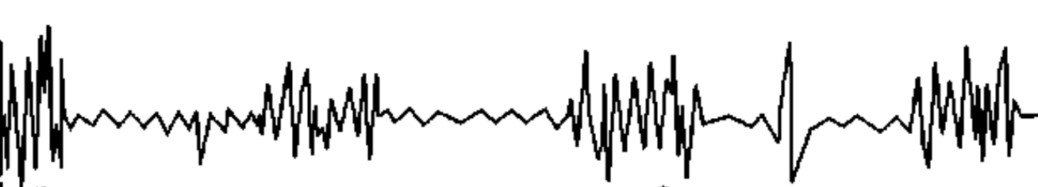

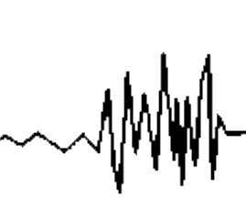
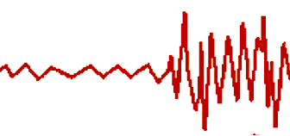
Field observations
Swim tests
U_{crit} / U_{max}
FATIGUE
Time to fatigue / endurance
LONG ( h), HIGH METABOLIC COST
SHORT (< h) MEDIUM METABOLIC COST
EMG tag
Recovery
RECOVER WHILE SWIMMING
ANAEROBIC
Muscle
activation
White muscle
Red muscle
AEROBIC
Sustained long timeframes, indefinite
Ellerby and Altringham JEB 2001
BURST
Speeds above what can be measured in swim flumes & tunnels
BURST
&
COAST
Swim speed
STEADY SWIM (FAST)
STEADY SWIM
SPRINT
PROLONGED
SUSTAINED
< 15 s
min
~ 30 min to 2 h
Hours to days
Timeframe

Slide 2
LONG ( h), HIGH METABOLIC COST
SHORT (< h) MEDIUM METABOLIC COST
Recovery
RECOVER WHILE SWIMMING
ANAEROBIC
Muscle
activation
White muscle
Red muscle
AEROBIC
Field observations
Swim tests
Ucrit / Umax
FATIGUE
Time to fatigue / endurance
Ellerby and Altringham JEB 2001
BURST
BURST
&
COAST
Swim speed
STEADY SWIM (FAST)
STEADY SWIM
SPRINT
PROLONGED
SUSTAINED
< 15 s
min
~ 30 min to 2 h
Hours, days
Timeframe

Slide 3
BURST &
COAST
Time to fatigue / endurance
Ucrit / Umax
Burst
STEADY SWIM
Swim speed
AEROBIC
ANAEROBIC
Muscle
activation
White muscle
Red muscle
SUSTAINED
PROLONGED
BURTS, SPRINT
SUSTAINED
PROLONGED
BURTS, SPRINT
Swim speed
Ellerby and Altringham JEB 2001
Burst
Field observations
Ucrit / Umax
Time to fatigue / endurance
Swim speed
STEADY SWIM
FATIGUE
BURST &
COAST
STEADY SWIM
Few sec
~ 30 min to 2 h
Several hours to definite
Short (sec)
Timeframe
Long (h, days)

